Slide 1
Lunar Life Odyssey Challenge Proposal for in situ production of Liquid Nitrogen (LN2) for Lunar Dust Mitigation
Rationales, Method and Design: A Urine (brine) Nitrogen Gas Processor Assembly (UNGPA) - Use of human urine brine as a sustainable source of Nitrogen for LN2 production via Biological (Microbial) Denitrification (BDN)
Presented by: Michael Ricciardi

Slide 2
The Problem: Space Suit, Equipment and Lunar Habitat contamination by fine particulate regolith (aka ‘lunar dust’)
HEALTH RISKS
1] Astronauts acquiring lunar ‘hay fever’ / asthma (and other respiratory conditions).
2] Possible immune disorders and/or cancers from micro/nano-scale silicate particle contamination of lungs and other organ tissues.
GENERAL/OPERATIONAL RISKS
3] Space suit abrasion and deterioration (from brushing off dust, washing, etc.)
4] Fouling (“gucking up”) of vital life support systems, scientific equipment, and general habitat spaces.

Slide 3
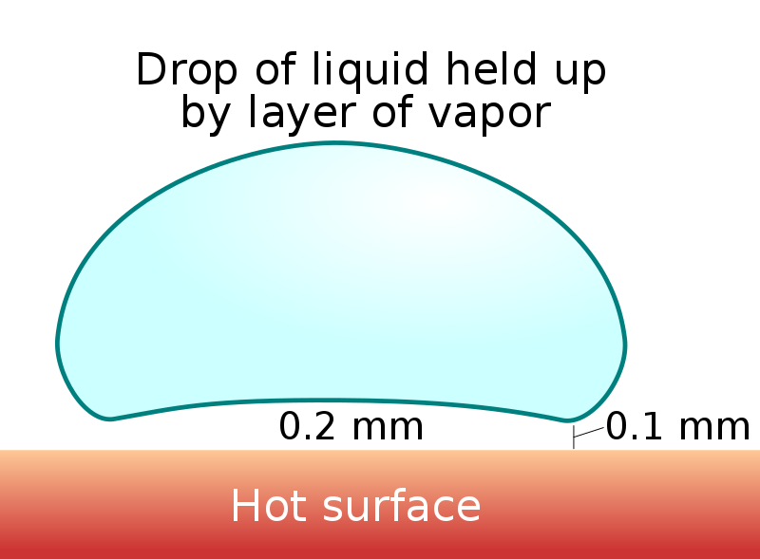
The Solution: Use of Liquid Nitrogen ‘Spraying’ of Astronaut Space Suits Prior to Habitat Entry
Terrestrial experiments with LN2 spraying (via ‘film boiling’) demonstrated superior mitigation (removal) of lunar dust simulacra (e.g., volcanic ‘glass’/silicate particles) under ambient and vacuum conditions (I. Wells et al., 2021, 2023) probably due to the ‘Leidenfrost Effect’ (or related phenomenon).
Summary of Results:
98.4% mean mass removal
95.9% removal of 10 micron or smaller particles
97% removal in terrestrial environments
>90% removal (in 1 second) in vacuum conditions

Slide 4
Related Solution Needs & Limitations
General need for Dinitrogen (N2) source (LSS)
Limited quantity of N2 used (and recycled) in lunar habitat Life Support System (LSS); not suitable for this purpose (re: need to preserve correct mixture [via ARS] of 80% N2 and 20% O2 ).
Transport of N2/LN2 to Moon base (via a ‘supply chain’) is doable but makes lunar excursions/missions and any habitat expansion dependent on existing supply AND reliable supply chain (possible delays, disruptions + transport costs).
Need for in situ and sustainable source of N2 (especially for ‘dual use’ LN2 airlock pressurization) AND in case of N2 leakage.

Slide 5
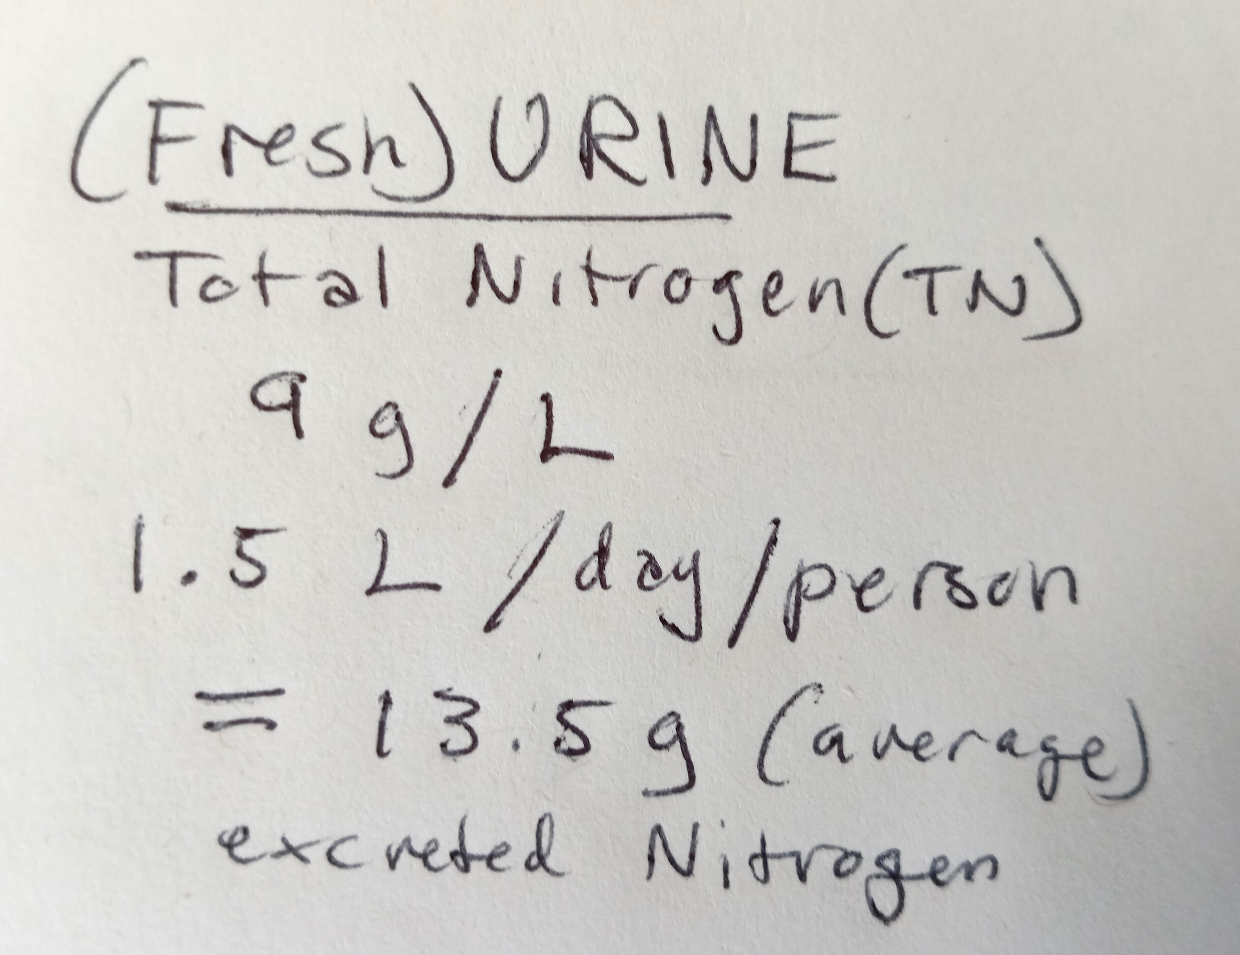
Identifying an in situ and Sustainable source of Nitrogen
Source #1: Existing Supply of N2 Gas (via LSS / ARS):
Diverting LSS nitrogen (N2) gas is problematic for maintaining an adequate (and recyclable) air mixture.
Increased Oxygen volume as a result of N2 diversion loss is dangerous (re: ‘ignition point’).
This source is not sustainable for the uses proposed/needed.
Source #2: Human Urine (as bulk wastewater or concentrated brine):
Existing/continuous waste stream/re-supply (via UPA/BPA)
This source of Nitrogen is sustainable for the uses proposed/needed.

Slide 6
How to extract usable Dinitrogen from Urine Wastewater or Brine?
Multiple methods exist but with limitations/drawbacks:
Electro-chemical stripping (end-product is NH4+SO4; needs + processing, energy inputs)
Hydrophobic gas separation membranes (air mixture; zeolites, non-liquid waste source)
Urea hydrolysis (end-product is MAP/’struvite’, requires + processing of NH4+)
Integrated fixed-film activated sludge (IFAS) reactor (high COD/N output, multiple bacterial species, complex, unknown anammox dynamics)
Microbial Denitrification – utilization of anaerobic bacteria (Pseudomonas*) for rapid reduction of urine nitrates (NO3-) –> end-product in ideal form: N2 ; cultured in quantity via a dedicated (DN microbe) bioreactor (or, use pre-made reductases).
*Ideal species: Pseudomonas stutzeri – well-researched [see: Carlson, C.A., Ingraham, J.L. (UC Davis), APPLIED and ENVIRONMENTAL MICROBIOLOGY (ASM), 1983. Note: No side-product NOx or N2O from P. stutzeri reduction of nitrate.

Slide 7
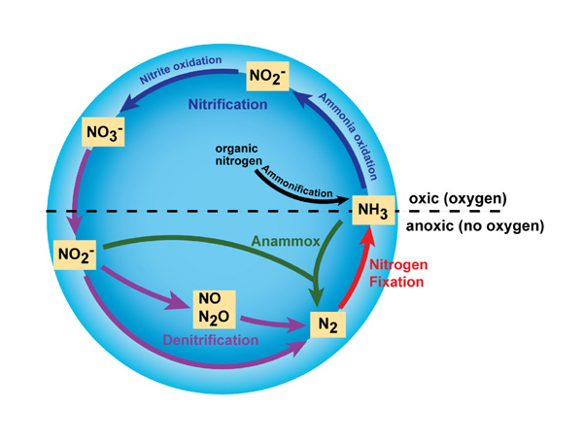
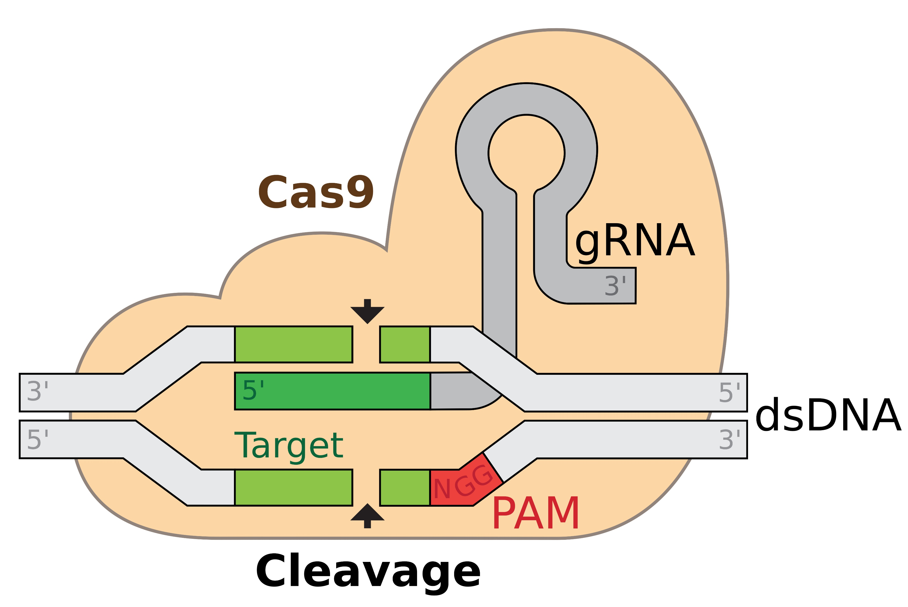
Enhancing Denitrifying Microbes to Increase Dinitrogen Gas Output
‘Anaerobic reduction’ of nitrates (source: NH4NO3 in urine brine) by Pseudomonas stutzeri (with carbon inputs for enhancement) results in production of dinitrogen (N2) which is the ideal form for our purposes (=>LN2).
Nitrate reduction is accomplished through the reductase enzyme NAR (nitrate reductase). Other enzymes (NIR, NOR, NOS), if activated, take part in intermediate reactions (with NOR and NOS reducing side-product gases Nitric Oxide and Nitrous Oxide, respectively).
Reductase enzyme genes may be modified by natural ‘enhancer’ and ‘promoter’ gene sequences. These promoters and enhancers can be edited (via CRISPR-Cas 9, Cas 12 /13 RNA variants, Prime ssDNA base-editing,) to boost their activity, and, thus boosting N2 output.
Alternatively, co-cultivation with anammox bacteria (Brocadia, Nitrospira) to increase nitrate volume via ammonia oxidation (460 mg/L of NH3 versus 0.06 mg/L of NO2-, NO3- ) as symbionts within urine substrate DN chamber.
Figure 1 (right, top) : Bernhard
Figure 2 (right, bottom) : by marius walter - File:GRNA-Cas9.png, CC BY-SA 4.0, https://commons.wikimedia.org

Slide 8
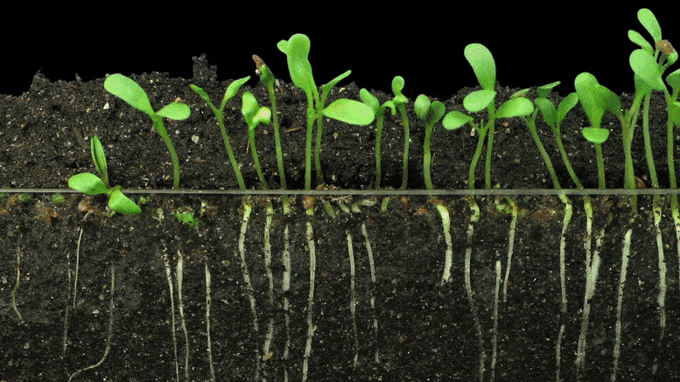
Added Benefits of Biological (Microbial) Denitrification (BDN)
A microbial BDN bio-system (with Pseudomonas or other DN/anammox species) can be run in parallel (i.e., part of an ‘artificial’ soil ecosystem) with an agri-bio (photosynthetic) system (plants: legume species) to provide a continuous source of dinitrogen (utilized for ammonification by nitrifying/‘fixing’ bacteria, such as Rhizobium) to provide a nutrient nitrogen source for plants.
As a ‘dual use’ application to provide LN2 pressurization for an airlock chamber/entry port to lunar habitat (also: a proposed MMSEV pressurized cabin [see: I. Stambaugh et al., NASA-JSC; M. Borrego et al., Jacobs Exploration].

Slide 9
Putting the Pieces Together: Designing UNGPA
A Urine (brine) Nitrogen Gas Processor Assembly (UNGPA) would ‘piggyback’ on the newly added Brine Processor Assembly (BPA (operationally adjacent to the WPA-UPA subsystem of the ECLSS).
A percentage of urine wastewater or brine would be continuously diverted from the BPA to serve as the substrate for our DN microbial population injected into a DN chamber (+ some carbon inputs, as needed; fecal or other biomass sources; sustainable).
Emitted N2 gas is collected, separated (from NOx, N2O species, depending on mix of microbial species used), and directed to a N2 collector/pressurizer and cryo-cooler system (in ‘lunar shadow’) for use in lunar de-dusting and airlock pressurization.

Slide 10
Introducing: UNGPA (original concept design: M. Ricciardi)

Slide 11
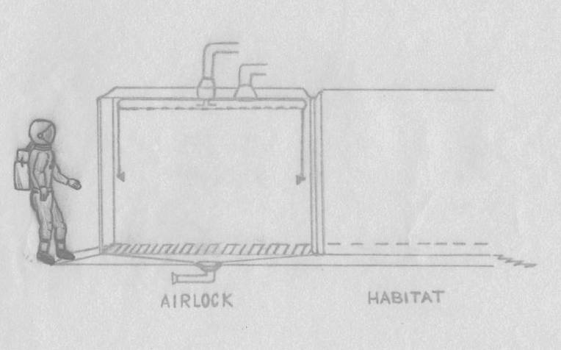
Airlock LN2 De-Dusting & Pressurization Design

Slide 12
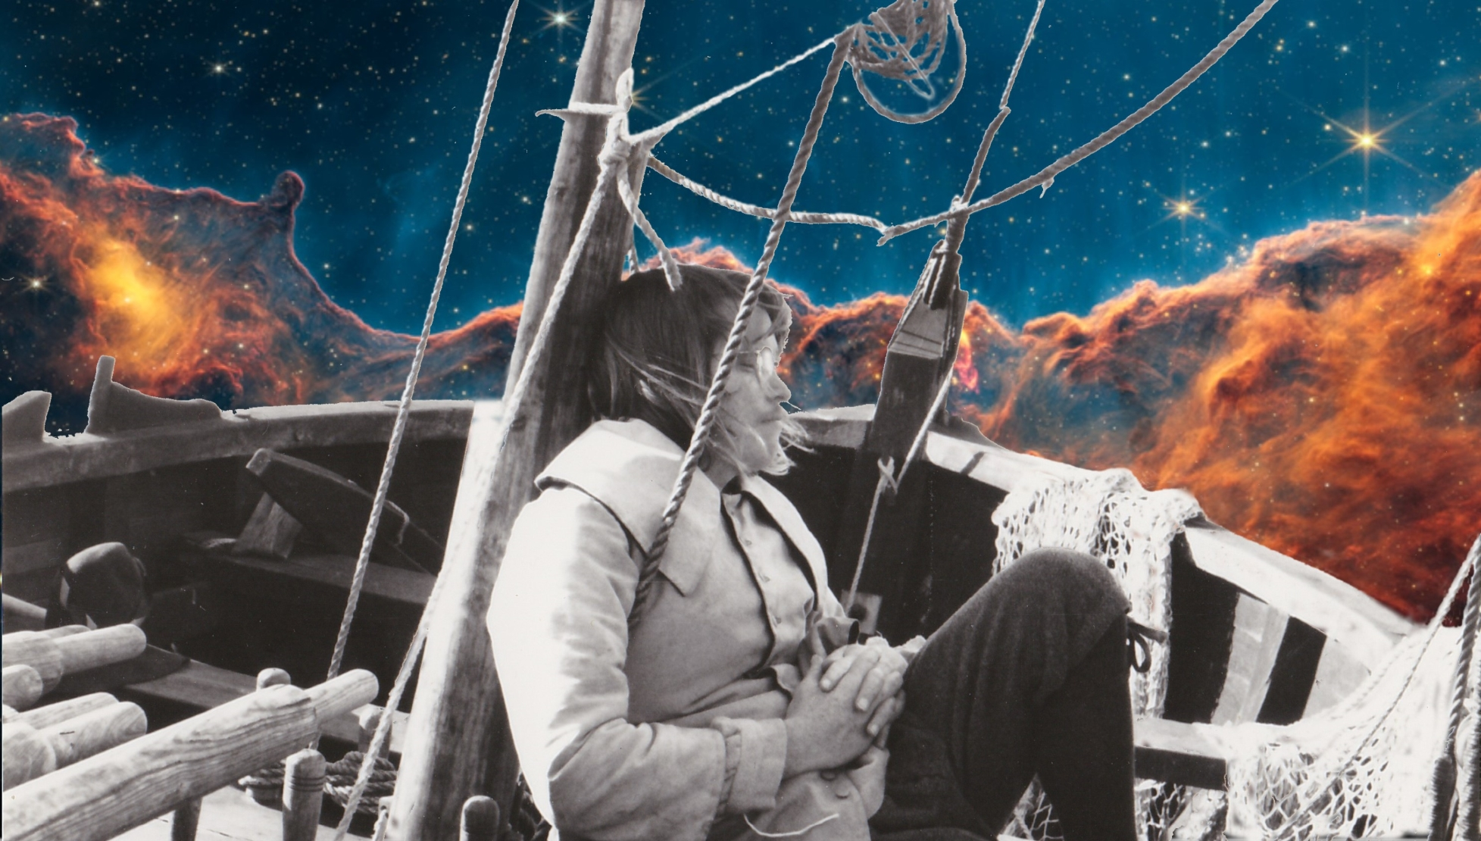
THANK YOU for your TIME and CONSIDERATION of this PROPOSAL

