Slide 1
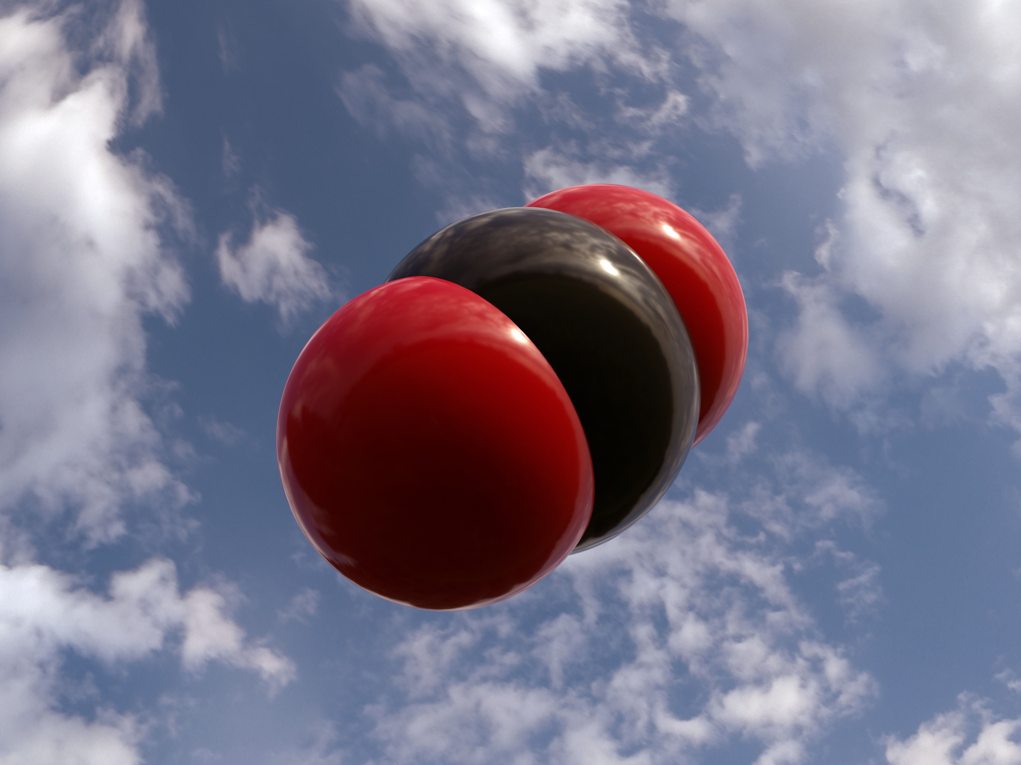
MOFs for DAC
Description & Applications of alpha-Magnesium formate (α-Mgf) MOFs for maximal direct air capture of CO2
Carbon Capture XPrize Concept – M. Ricciardi (Team Yummet)
Image by thoughtco.com

Slide 2
Metal Organic Frameworks (MOFs)
Type: Alpha-Magnesium formate (α-Mgf)
IUPAC name: Mg(HCO₂)₂
> MOF architectures can be 1D, 2D, or 3D
> α-Mgf MOFs (and related forms) are HIGHLY selective for CO₂
> MOFs have extremely large surface areas relative to their small volume (up to several thousands of m² /gm), thus
> great CO₂ adsorption capacity/potential.
Note: the highest reported CO₂ capture content on a MOF was an amine-loaded Mg-DOBDC - a Magnesium cluster with terephthalic acid (or Magnesium diformate).

Slide 3
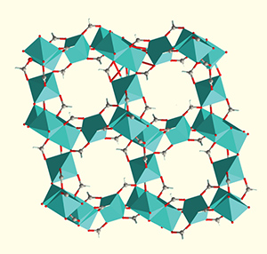
Idealized crystal-structure rendering of an α-Mgf MOF (image: National MagLab). MOF crystal lattices (comprised of transition metal ion ‘nodes’ and organic ligand / ‘linker’ molecules) can be arrayed in 1D, 2D (for anisotropic gas diffusion) or 3D (for isotropic gas diffusion) architectures. MOF pore sizes can be enlarged/narrowed via addition of SiF₆ (‘SIFSIX’) double anion ‘linkers’ (overcoming trade-off in capacity v. selectivity; see also: Cui et al [acetylene/ethylene], Cadiau et al [propylene/propane] for other ‘tunable’ MOF polymer mixtures).

Slide 4
Additional Technical Information on MOFs:
The MOF architecture selectively adsorbs CO₂ (at each nodal juncture) as air passes over/through it (measured in kmol/hr). Trapped gas may be released via optical stimulation, thermal (temperature) manipulation and/or liquid* immersion.
MOF volumes/quantities may be scaled up using new ‘green’ mechano-synthesis method LA-RAM (Liquid-Assisted Resonant Acoustic Mixing; see: H.M. Titi et al) or other method (e.g., continuous solvothermal synthesis).
*Note: industrial acids/solvents are typical liquids used in these processes; recommend using aprotic ‘green’ solvents, which are less chemically dangerous/harmful [C. Cogswell].

Slide 5





Problem/Challenge: α-Mgf MOFs possess significant hydrophilicity (‘water-loving’ capacity, thus significant H₂O absorption) and experience related chemical breakdown, preventing effective deployment in air (as air contains water vapor).
H2O + α-Mgf
= BAD

Slide 6
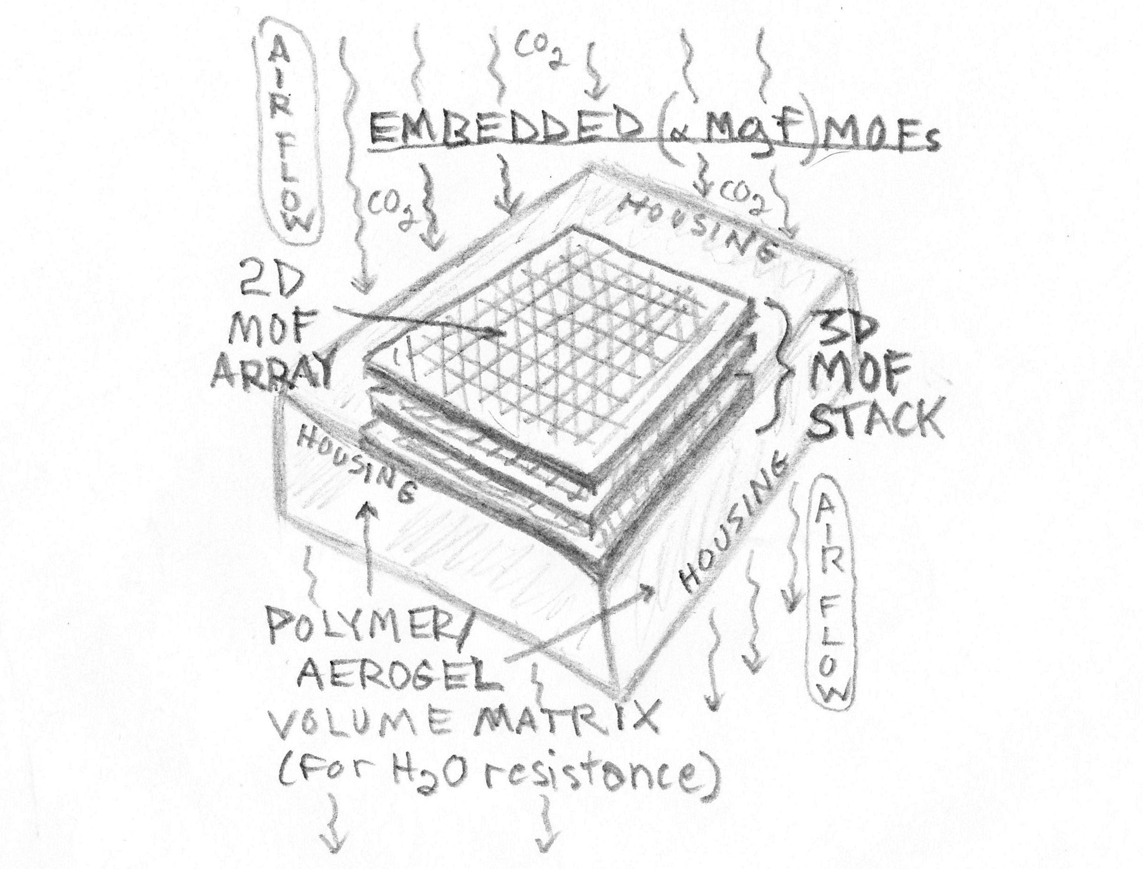
Solution: Embed or ‘fix’ the MOF to a water-resistant polymer matrix (a polymer + MOF ‘mixture’), so that water degradation is prevented, or, alternatively, use ‘MOF-like’ (silicate) structures, or, Mixed Matrix Membranes* (combining a permeable, non-hygroscopic or hydrophobic polymer mixture and/or, aerogel, with MOF) that are more water-resistant than standard MOFs.
*see: S. Budhathoki et al

Slide 7
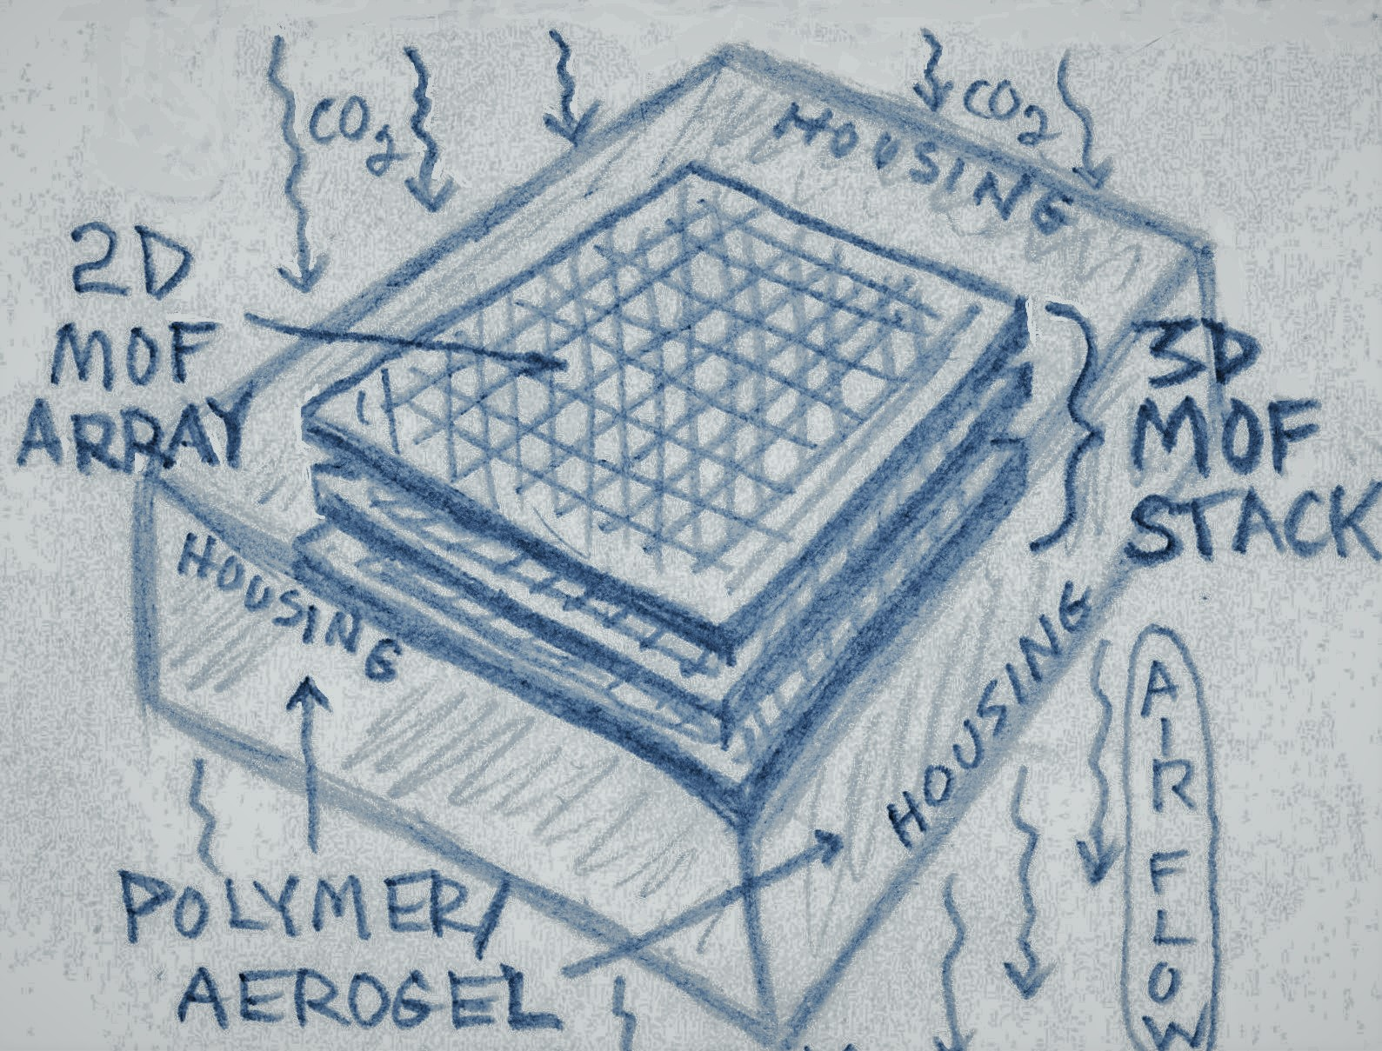
General Applications:
1] ‘Insertion’ or integration of MOFs/MOF-like structures (MMMs) in 2D or 3D arrays (‘stacks’) into/with complimentary DAC technology (i.e., existing or novel carbon capture systems) for enhanced CO₂ adsorption/absorption (whether atmospheric, oceanic, or point source).
2] Use of MOFs (or COFs – covalent organic frameworks) for ‘molecular sieving’ and gas separation (post direct air capture) systems. Note: COFs created via reticular synthesis [see: Adotya Balpande, ASU]
Applications (continued)….

Slide 8
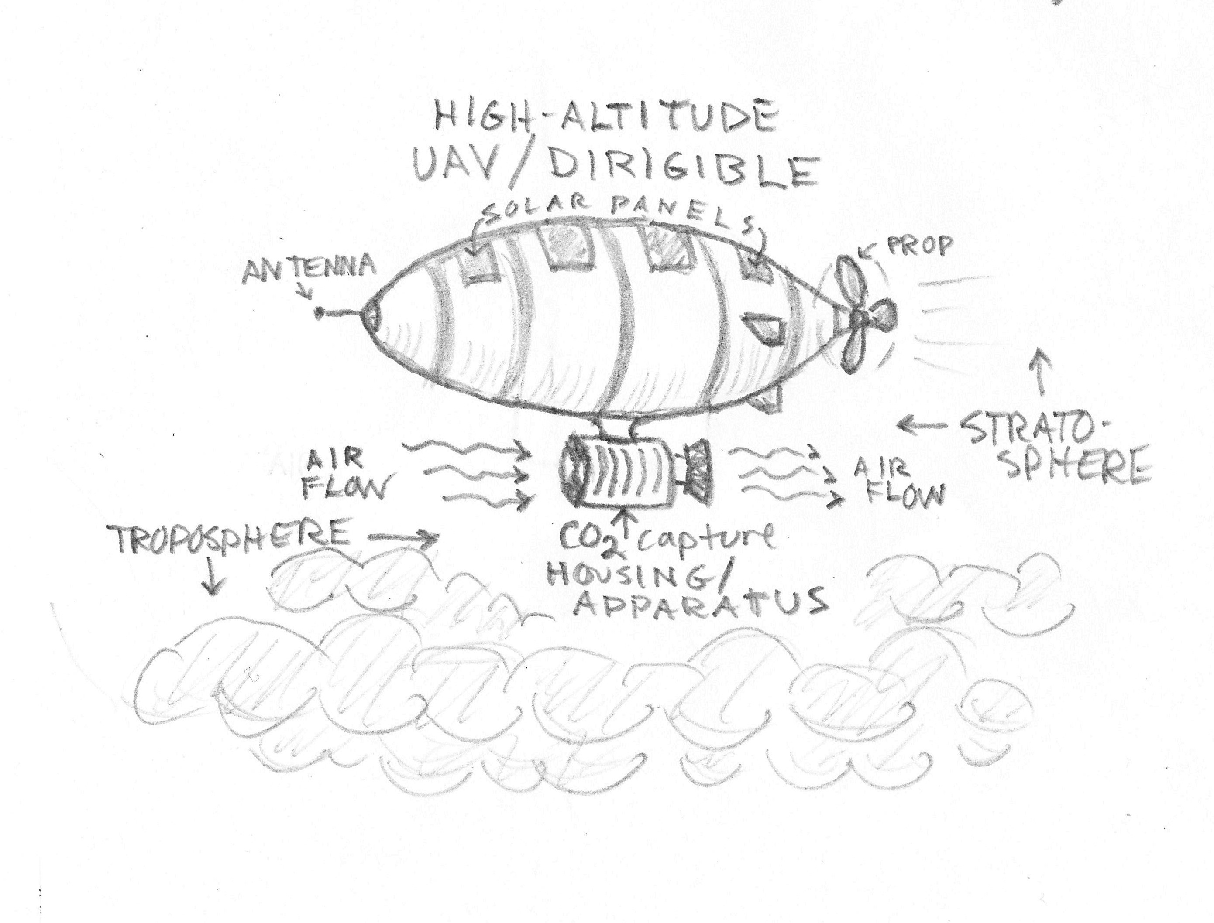
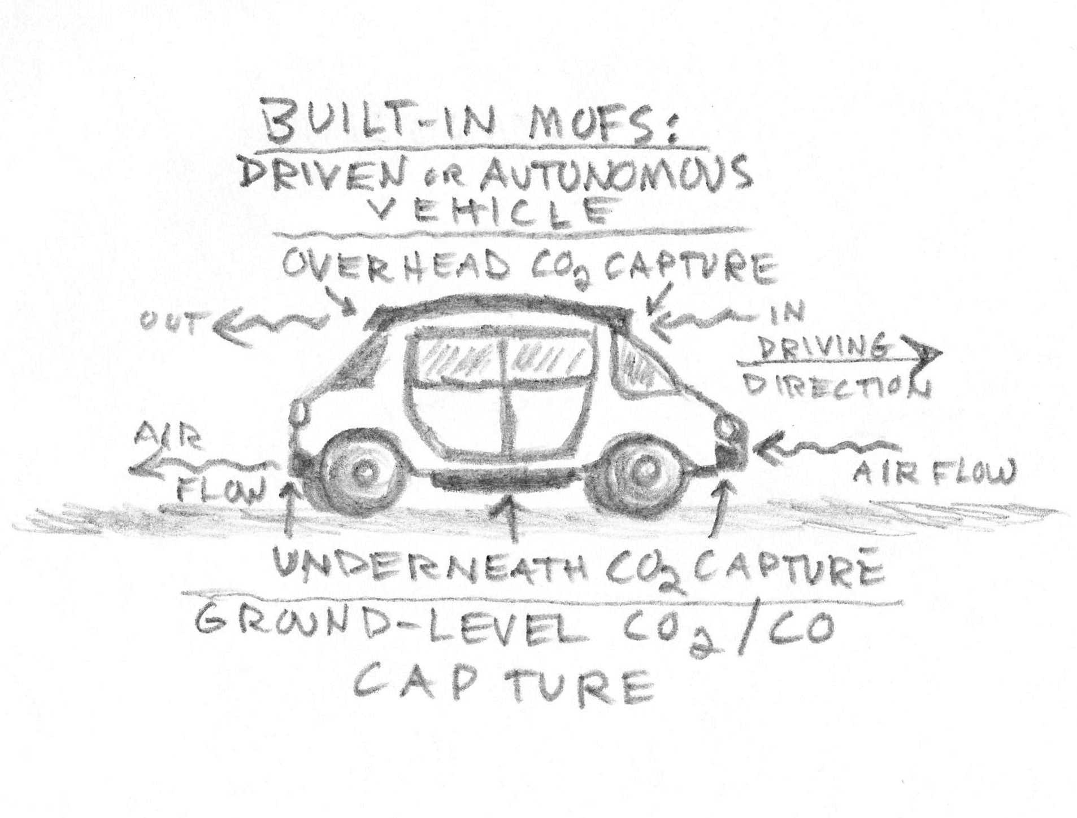
Applications (continued):
3] Dedicated (specific) applications -- use of water-resistant (non hygroscopic) stacked 2D/3D arrays of α-Mgf MOFs in:
A] (a fleet of) high-altitude UAVs/dirigibles
(funded via public-private partnership) for
capturing atmospheric CO₂
at troposphere-stratosphere boundary
[app. idea: M. Ricciardi]
B] Driven or Autonomous vehicles
(consumer/corporate-enabled); MOF
arrays/stacks as (built-in/standard equipment)
‘filters’ for capturing ground-level CO₂
[app. idea: C. Cogswell]

Slide 9
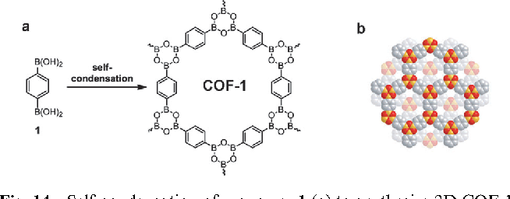
Sequestration/Storage via Repurposing & Utilization:
1] CO₂ (under full containment conditions and high pressure) is dissolved into bio-degradable plastics; the pressure is then rapidly reduced, creating a bulky but light-weight foam (for reuse as insulation and floatation devices/buoys), thus repurposing the plastics.
[see: ‘Recycling and rheology of poly(lactic acid)(PLA) to make foams using supercritical fluid’, L. Lin et al 29 June 2021, Physics of Fluids.
DOI: 10.1063/5.0050649 ]
2] Carbon separation (e.g., via ‘molecular sieving’, MOFs / COFs) and binding with Silicon to create SiC (silicon carbide, aka: carborundum) for use
in electronics and other commercially valuable materials.
[see: “Plant-based CO2 drawdown and storage as SiC”, Suzanne T. Thomas, Yongsoon Shin, James J. La Clair, and Joseph P. Noel, 27 April 2021, RSC Advances. DOI: 10.1039/d1ra00954k ]

Slide 10


Cost Considerations (example: DAC via MMMs): Performance indicators based upon varying (simulated) CO2 permeances (at 34, 1170, or 8000 GPU) according to S. Budhathoki et al are:
CO2/N2 selectivity →
Compression cost ($/MWh) +
Vacuum pump cost ($/MWh) +
Membrane area cost ($/MWh) + = Cost* of CO₂ Captured ($/ton)
Liquefaction cost ($/MWh) +
Cost of Electricity (COE) (%) +
Net Power Output (MWe_)
*For actual $ amounts per GPU level, and selectivity categories, see page 10, table 4 – ‘High-throughput Computational Prediction of the Cost of Carbon Capture using Mixed Matrix Membranes’ (S. Budhathoki et al); Energy & Environmental Science (Royal Chemical Society), 2018. [for system schematic, see page 6]

